Slide 1
Chapter 8: Class and Method Design

Slide 2
Objectives
Become familiar with coupling, cohesion, and connascence.
Be able to specify, restructure, and optimize object designs.
Be able to identify the reuse of predefined classes, libraries, frameworks, and components.
Be able to specify constraints and contracts.
Be able to create a method specification.

Slide 3
Introduction
Review the characteristics of object orientation
Present useful criteria for evaluating a design
Present design activities for classes and methods
Present the concept of constraints & contracts to define object collaboration
Discuss how to specify methods to augment method design
Caution:
Class & method design must precede coding
While classes are specified in some detail, jumping into coding without first designing them may be disastrous
Notes:
What is the common language for Object Orientation?
Why the methodology associated with Object Orientation focus an Class & Method Design or Detailed pre coding Design?.

Slide 4
Characteristics of OOSAD
Classes
Instantiated classes are objects
Classes are defined with attributes, states & methods
Classes communicate through messages
Encapsulation & information hiding
Combine data and operations into a single object
Reveal only how to make use of an object to other objects
Key to reusability
Polymorphism & dynamic binding
Inheritance
Notes:
The basic characteristics of object-oriented systems are: Classes, objects, methods, and messages. Which of the three (3) is the basic unit or foundation?
Why are objects encapsulated?
What value does Polymorphism & Inheritance have?

Slide 5
Polymorphism & Dynamic Binding
Polymorphism
The ability to take on several different forms
Same message triggers different methods in different objects
Dynamic binding
Methods—the specific method used is selected at run time
Attributes—data type is chosen at run time
Implementation of dynamic binding is language specific
Decisions made at run time may induce run-time errors
Need to ensure semantic consistency
Notes:
What is dynamic binding?
Explain the concept of polymorphism.
How does Polymorphism relate to dynamic binding?

Slide 6
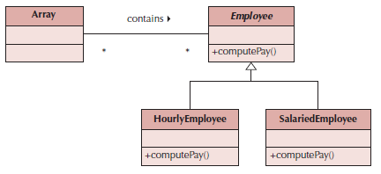
Polymorphism Example
Notes:
Give an example of a "bad" use of polymorphism.

Slide 7
Inheritance
Permits reuse of existing classes with extensions for new attributes or operations
Types
Single inheritance -- one parent class
Multiple inheritance -- multiple parent classes (not supported by all programming languages)
Redefinition of methods and/or attributes
Not supported by all programming languages
May cause inheritance conflict
Designers must know what the chosen programming language supports
Notes:
Describe the concept of inheritance.
Are there different types of inheritance?
Is cancellation of a method in an existing inheritance model a good or bad thing? Why?
Is an organization chart BOD -> CEO -> MGR -> Employee a good inheritance template?

Slide 8
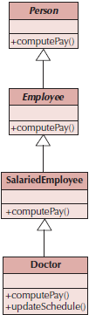
Inheritance Conflicts
An attribute or method in a sub-class with the same name as an attribute or method in the super class
Cause is poor classification of sub-classes:
Generalization semantics are violated, or
Encapsulation and information hiding principle is violated
May also occur in cases of multiple inheritance
Notes:
What is an example of an inheritance conflict?
How do you avoid inheritance conflicts?

Slide 9
Design Criteria
A set of metrics to evaluate the design
Coupling—refers to the degree of the closeness of the relationship between classes
Cohesion—refers to the degree to which attributes and methods of a class support a single object
Connascence—refers to the degree of interdependency between objects
Notes:
Is it important to know which object-oriented programming language is going to be used to implement the system?

Slide 10
Coupling
Close coupling means that changes in one part of the design may require changes in another part
Types
Interaction coupling measured through message passing
Inheritance coupling deals with the inheritance hierarchy of classes
Minimize interaction coupling by restricting messages (Law of Demeter)
Minimize inheritance coupling by using inheritance to support only generalization/specialization and the principle of substitutability
Notes:
What is coupling?
Is coupling a good thing or a bad thing?

Slide 11
Law of Demeter
Messages should be sent only by an object:
to itself
to objects contained in attributes of itself or a superclass
to an object that is passed as a parameter to the method
to an object that is created by the method
to an object that is stored in a global variable
Notes:
What is the Law of Demeter?

Slide 12
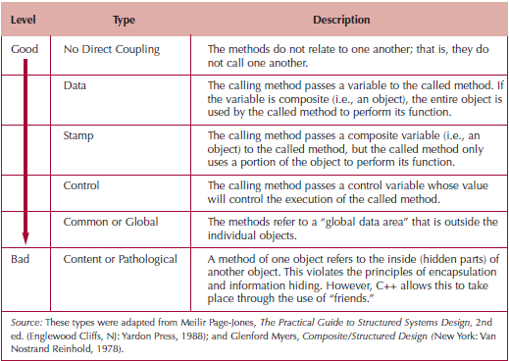
Types of Interaction Coupling
Notes:
What is interaction coupling?
How can interaction coupling be minimized?
Is it possible to eliminate all coupling / message induced dependencies?
What is an example of "good" interaction coupling?
What is Inheritance coupling?.
Is loosely coupled good & tightly coupled bad with Interaction coupling?

Slide 13
Cohesion
A cohesive class, object or method refers to a single thing
Types
Method cohesion
Does a method perform more than one operation?
Performing more than one operation is more difficult to understand and implement
Class cohesion
Do the attributes and methods represent a single object?
Classes should not mix class roles, domains or objects
Generalization/specialization cohesion
Classes in a hierarchy should show “a-kind-of” relationship, not associations or aggregations
Notes:
What is cohesion?
Is high cohesion or low cohesion more desirable in a system?
What is Generalization/Specialization cohesion?

Slide 14
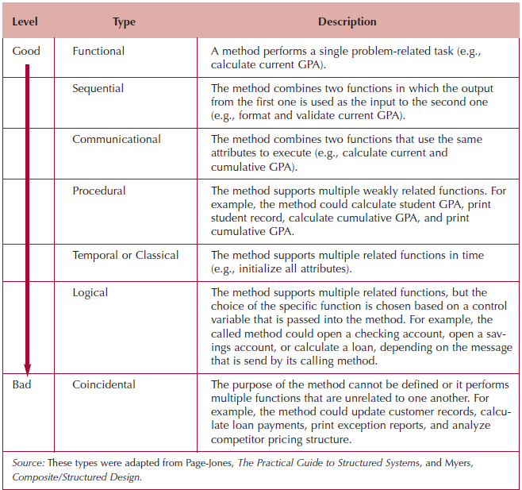
Types of Method Cohesion
Notes:
What is method cohesion?
Is there such a thing as "good" method cohesion?
Is there such a thing as "bad" method cohesion?

Slide 15
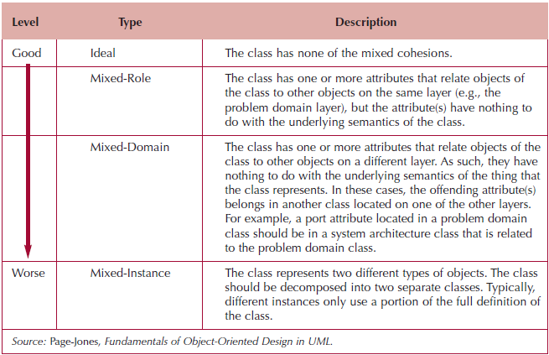
Types of Class Cohesion
Notes:
What is class cohesion?
What is mixed-role cohesion?
What is mixed-instance cohesion?
.

Slide 16
Is high cohesion or low cohesion more desirable in a system?

Slide 17
Are there different types of inheritance?

Slide 18
Is an organization chart BOD -> CEO -> MGR -> Employee a good inheritance template?

Slide 19
Give an example of a "bad" use of polymorphism.

Slide 20
What is dynamic binding?

Slide 21
How does Polymorphism relate to dynamic binding?.

Slide 22
Why are objects encapsulated?

Slide 23
What value does Polymorphism & Inheritance have?

Slide 24
A class/object should only represent one thing, and a method should only solve a single task. This principle is often referred to as _____.
a. coupling
b. cohesion
c. connascence
d. multiple inheritance
e. none of these

Slide 25
What is coupling?

Slide 26
Is coupling a good thing or a bad thing?

Slide 27
What is cohesion?

Slide 28
What is method cohesion?

Slide 29
In order to get an object to perform a method, a(n) _____ is sent to the object.
a. state
b. object
c. attribute
d. message
e. instance

Slide 30
Dynamic binding refers to the ability of object-oriented systems to defer the data typing of objects to run time.
T / F

Slide 31
A method that combines two functions that use the same attributes to execute exhibits Communicational cohesion.
T / F

Slide 32
What is inheritance coupling? How can inheritance coupling be minimized?

Slide 33
Explain the concept of polymorphism.

Slide 34
Is there such a thing as "good" method cohesion

Slide 35
Connascence
Classes are so interdependent that a change in one necessitates a change in the other
Good programming practice should:
Minimize overall connascence; however, when combined with encapsulation boundaries, you should:
Minimize across encapsulation boundaries (less interdependence between or among classes)
Maximize within encapsulation boundary (greater interdependence within a class)
A sub-class should never directly access any hidden attribute or method of a super class
Notes:
What is connascence?
Is connascence ever desirable in a system?

Slide 36
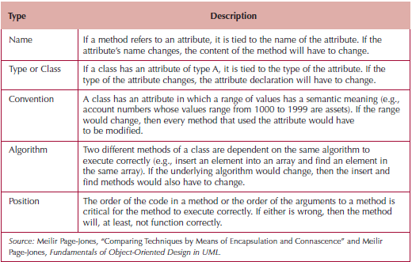
Types of Connascence
Notes:
What is name connascence?
What is convention connascence?
What is algorithm connascence?
What is position connascence?

Slide 37
Object Design Activities
An extension of analysis & evolution activities
Expand the descriptions of partitions, layers & classes by:
Adding specifications to the current model
Identifying opportunities to reuse classes that already exist
Restructuring the design
Optimize the design
Map the problem domain classes into a programming language
Notes:
Why is it necessary for an analyst to detail the specifications for the individual classes and methods?
What must method specifications always include?

Slide 38
Problems with Natural English
Many do not write well and do not question writing abilities.
Many too educated to communicate with general audience
Some write everything like it was a program.
Can allow computing jargon, acronyms to dominate language.
Statements frequently have excessive or confusing scope.
Overuse compound sentences.
Too many words have multiple definitions.
Too many statements use imprecise adjectives.
Conditional instructions can be imprecise.
Compound conditions tend to show up in natural English.
Source: Adapted from Matthies, Leslie, The New Playscript Procedure, (Stamford, CT: Office Publications, Inc. 1977)
Notes:
Plain old English is a problem because of things like: education impedes communication to non-educated people. What does structured English do that resolves these issues?

Slide 39
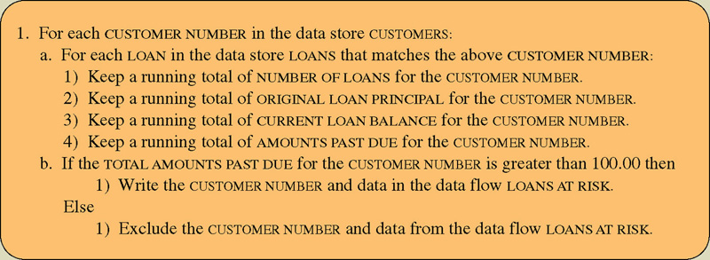
Structured English
Structured English – a language syntax for specifying the logic of a process.
Based on the relative strengths of structured programming and natural English.
Notes:
How does Structured English solve the problems associated with natural English?

Slide 40
Adding Specifications
Review the current set of analysis models
All classes included are both sufficient and necessary to solve the problem
No missing attributes or methods
No extra or unused attributes or methods
No missing or extra classes
Examine the visibility of classes
Private—not visible
Public—visible to other classes
Protected—visible only to members of the same super class
Notes:
When designing a specific class, what types of additional specification for a class could be necessary?
When we say the system must respond to violations what do we mean?
How do you verify and validate class and method design?

Slide 41
Adding Specifications (cont.)
Decide on method signatures:
Name of the method
Parameters or arguments to pass
Type of value(s) to be returned
Define constraints that must be preserved by the objects
Preconditions, post-conditions, & invariants
Decide how to handle constraint violations
Notes:
What are constraints?
What are exceptions?

Slide 42
Identify Opportunities for Reuse
Design patterns—groupings of classes that help solve a commonly occurring problem
Framework—a set of implemented classes that form the basis of an application
Class libraries—also a set of implemented classes, but more general in nature than a framework
Components—self-contained classes used as plug-ins to provide specific functionality
Choice of approaches depends on the layer
Notes:
What are patterns?
What are frameworks?
What are class libraries?.
What are components?
How are the four approaches on this slide used to enhance the evolving design of the system?

Slide 43
Restructuring the Design
Factoring—separating aspects from a class to simplify the design
Normalization—aids in identifying missing classes
Assure all inheritance relationships support only generalization/specialization semantics
Notes:
What is factoring?
What is normalization?

Slide 44
Optimizing the Design
Balance understandability with efficiency
Methods:
Review access paths between objects
Review all attributes of each class
Review direct (number of messages sent by a method) and indirect fan-out (number of messages by methods that are induced by other methods)
Consider execution order of statements in often-used methods
Avoid re-computation by creating derived attributes and triggers
Consider combining classes that form a one-to-one association
Notes:
Why do we review the access paths between objects?
Why do we review each attribute for each class?
Why do we review the direct and indirect fan-out of each method?
Why do we look at the execution order of the statements in often-used methods?
Are there any downsides of optimizing a system?

Slide 45
Mapping Problem-Domain Classes
Factor out multiple inheritance if using a language that supports only single inheritance
Factor out all inheritance if the language does not support inheritance
Avoid implementing an object-oriented design in non-object languages
Notes:
If your analysis was done using Object Orientation methodology, are there any issues using C as the language for your implementation?
If your analysis was done using Object Orientation methodology, are there any issues using Java, Small Talk or Visual Basic as an implementation language?
Is factoring out multiple inheritance difficult?

Slide 46
Constraints and Contracts
A contract is a set of constraints & guarantees
If the requestor (client) meets the constraints, the responder (server) will guarantee certain behavior
Constraints must therefore be unambiguous
Contracts document message passing between objects
A contract is created for each visible method in a class
Should contain enough information for the programmer to understand what the method is supposed to do
Constraint types
Precondition—must be true before the method executes
Post-condition—must be true after the method finishes
Invariant—must always be true for all instances of a class
Notes:
What is the purpose of a contract?
How are contracts used?
What is an invariant?
What kind of constraints are common in object-oriented design?
What is the Object Constraint Language?
What is its purpose?

Slide 47
Method Specification
Documentation details for each method
Allows programmers to code each method
Must be explicit and clear
No formal standards exist, but information should include:
General information (e.g., method name, class name, etc.)
Events—anything that triggers a method (e.g., mouse click)
Message passing including values passed into a method and those returned from the method
Algorithm specifications
Other applicable information (e.g., calculations, procedure calls)
Notes:
Why do analysts need to make sure each class & method is described in gory detail?
How do you specify a method's algorithm?

Slide 48
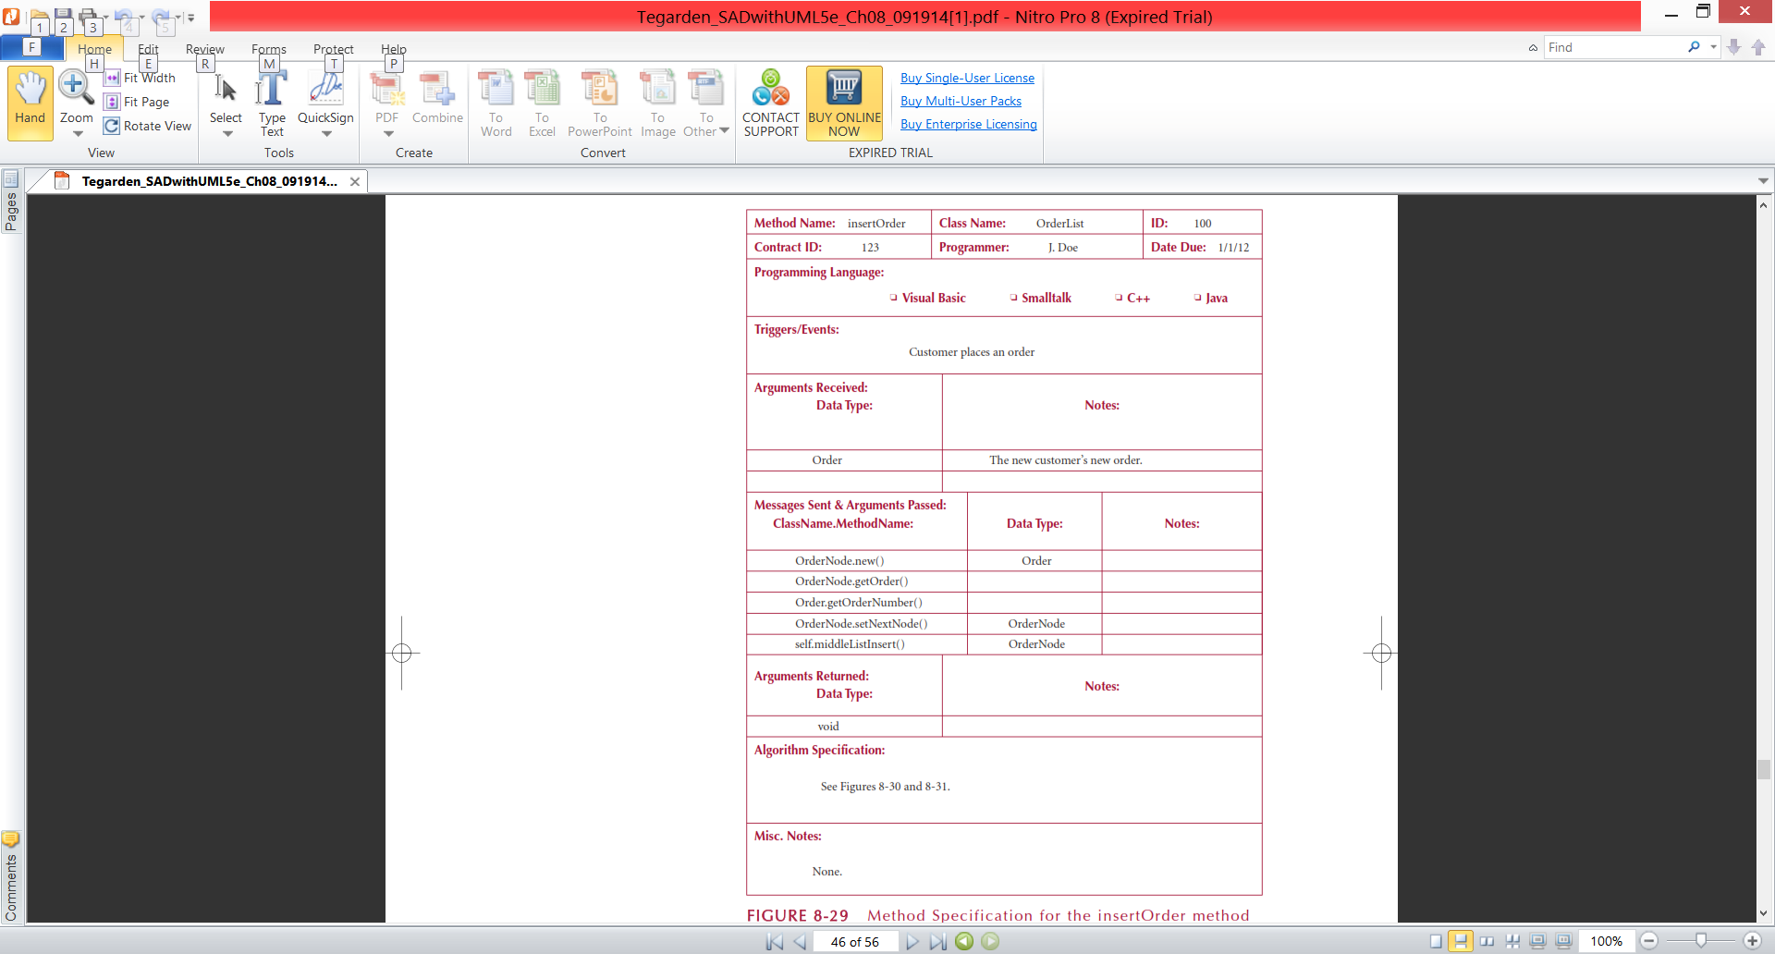
Method Specification Form
Notes:
What do you do if your method requires a complex algorithm?
What kind of information should be included in the last section of the method specification form?

Slide 49
How are contracts used?

Slide 50
What is an invariant?

Slide 51
What are class libraries?

Slide 52
What are components?

Slide 53
If your analysis was done using Object Orientation methodology, are there any issues using Java, Small Talk or Visual Basic as an implementation language?

Slide 54
Is factoring out multiple inheritance difficult?

Slide 55
Are there any downsides of optimizing a system?

Slide 56
What is factoring?

Slide 57
What is normalization?

Slide 58
What are constraints?

Slide 59
What are exceptions?

Slide 60
Why is it necessary for an analyst to detail the specifications for the individual classes and methods?

Slide 61
What is connascence?

Slide 62
Is connascence ever desirable in a system?

Slide 63
What is name connascence?

Slide 64
What is convention connascence?

Slide 65
A class has an attribute in which a range of values has a semantic meaning. This class has _____ connascence.
a. Name
b. Type or Class
c. Convention
d. Algorithm
e. Position

Slide 66
Which of the following Structured English statements is an advanced form of an IF statement?
a. action statement
b. For statement
c. While statement
d. Case statement
e. Do statement

Slide 67
The constraints and contracts in class and method design models were derived from the ____________ requirements and the problem domain representations.
a. business
b. regularly
c. non-functional
d. functional
e. reliability

Slide 68
Fan-out refers to the number of attributes passed by one object to another.
T / F

Slide 69
Clicking a mouse can be an event.
T / F

Slide 70
A post-condition is a constraint that must be met for a method to execute.
T / F

Slide 71
What is Generalization/
Specialization cohesion?

Slide 72
What are the three types of constraints typically captured in object-oriented design?

Slide 73
Briefly discuss the procedure for verifying and validating class and method design.

Slide 74
Rock Solid Outfitters
Read Rock Sold Outfitters
(Class Handout)

Slide 75
Rock Solid Outfitters
Design the table with three possible conditions and two possible outcome as described in the case
Then simplify the rules
Combine your table into just five rules

Slide 76
Rock Solid Outfitters
Design the table with three possible conditions and two possible outcome as described in the case

Slide 77
Rock Solid Outfitters
Then simplify the rules

Slide 78
Rock Solid Outfitters
Combine your table into just five rules

Slide 79
Genex Fuels
Background
Grown through acquisition
Finds itself with a mishmash of hardware, software, applications and databases
IT cannot support the enterprise effectively
What are some other specific background / organizational issues that Sandy is currently facing?

Slide 80
Genex Fuels
What evidence is the CEO using to suggest that Genex is not using technology competitively?

Slide 81
Genex Fuels
Did Devlin need to hire Sandy, a “high-priced technology consultant,” to tell him that technology at Genex was a mess?

Slide 82
Genex Fuels
Devise a strategy to successfully implement enterprise wide systems (such as SAP) at Genex.

